Slide 1
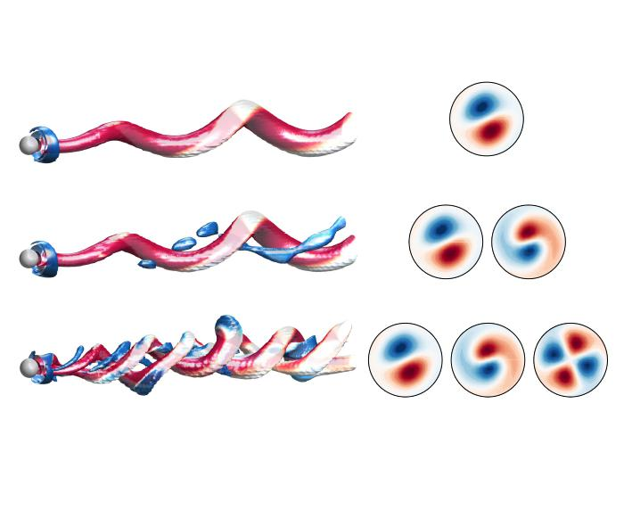
GLOBAL MODES COMPETITION IN THE STREAMWISE ROTATING SPHERE
BIFURCATION SCENARIO
M. Lorite-Díez, J. Sierra-Ausín, J.I. Jiménez-González,
V. Citro and D. Fabre
14th ERCOFTAC SIG 33 WORKSHOP
15 – 17 June, Cádiz, 2022
Notes:
-Greeting: name, chairman
-Side project during PhD, side project during my postdoc, meeting with Vincenco
-Interest of both groups in the problem: UJA (Stabilizing effect of rotation, control of flows, description flow regimes), IMFT (axisymmetric study where co-dimension 2 or 3 appears).

Slide 2
Contents
Motivation
Problem description
Background
Objectives
Stability tools
Linear stability analysis (LSA)
Sensitivity & control
Normal form reduction
Direct numerical simulations (DNS)
Conclusions
14th ERCOFTAC SIG 33 WORKSHOP
M. Lorite – Díez et al.
1/16
Notes:
Outline of the presentation, how the ideas are going to be discussed,
First: we’ll see what is the interest of this problem, applications and results/models that can be useful
Then, how we face the study of the problem (geometry, equations and parameters…)
What other groups have done in the past and finally what we do here: Two approaches (Stability and DNS)
I’ll finish with conclusions

Slide 3
Motivation
Applications: particle-driven flows, fluidized bed combustion, sport aerodynamics, seeds’ flight and freely rising and falling spheres
Rotation breaks the axisymmetry of the problem, altering the flow regimes
We focus on the laminar transitions of the sphere¹
Steady bifid wake (SS)
¹Tomboulides & Orszag (JFM 1600)
Rotating sphere of water in microgravity
Vortex-shedding in axial reflection symmetry plane (RSP)
Irregular vortex-shedding
14th ERCOFTAC SIG 33 WORKSHOP
M. Lorite – Díez et al.
2/16
Notes:
The flow around a rotating sphere is present in many applications: where we have suspensions, drops (we can see the movie), sports, seeds, free falling/rising spheres.
Generally, the introduction of rotation breaks the axisymmetry of the problem and the Flow regimes are going to be affected. Among the different types of Flow around a static sphere, we have picked laminar regime (and the subsequent transitions) to apply the rotation. One of main objectives is to observe how these transitions/regimes are affected. I bet you are familiar with these bifurcations, but I’ll remind them to you…
The axisymmetric wake behind a static sphere (Trivial state) starts to be steady planar symmetric (SS regime) at Re=212 after a pitchfork bifurcation.
After that, if we keep increasing Re (above Re= 272), the wake starts to be unsteady and vortex shedding is produced, however, the reflection symmetry plane is conserved (RSP regime). Finally, this symmetry plane is lost when we increase the Re above 350 and the wake starts to oscillate transversely.
Taking this into account, if we apply rotation….

Slide 4
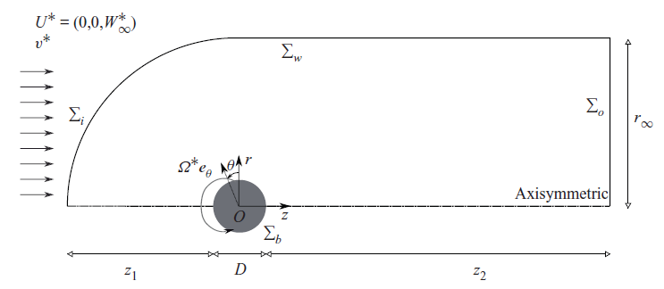
Problem description
Two parameters: rotation, Ω and Reynolds number, Re
Streamwise rotation in uniform flow
14th ERCOFTAC SIG 33 WORKSHOP
M. Lorite – Díez et al.
3/16
Notes:
We have two parameters: Reynolds (as before) and rotation parameter, \Omega
The rotation can be applied in different directions, many people has studied transversely rotation (where Magnus effect appears) but streamwise rotation has received considerably less attention and some questions remain unanswered.
Therefore, to study the problem we have built the following computational domain that’ll be employed in stability tools and DNS. The problem is governed by NS equations, and we vary the two aforementioned parameters.
In comparison with the classic problem of the flow around a static sphere, here, we have just introduced another boundary condition, where we give a streamwise rotation (in azimuthal direction) to the whole sphere. As you see, it is a simple set-up, therefore

Slide 5
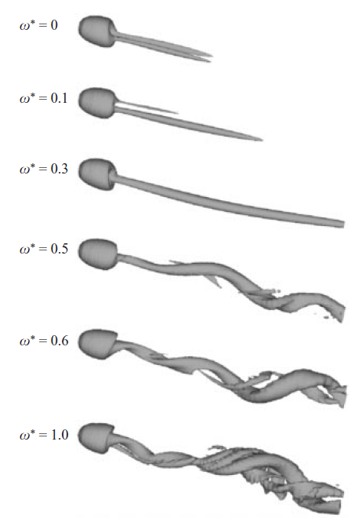
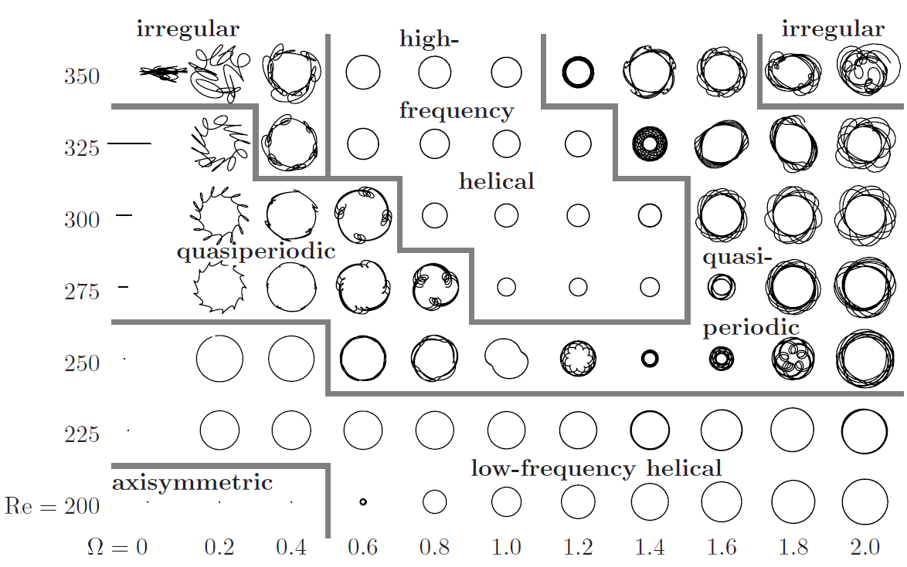
Background
Previous studies at small rotation rates: periodic (Low-helical frozen regime) and quasiperiodic (with vortex shedding) regimes
Re =250
Kim & Choi (JFM02)
Pier (JFS12)
14th ERCOFTAC SIG 33 WORKSHOP
M. Lorite – Díez et al.
4/16
Notes:
Some other people have studied the problem earlier, giving some partial answers and we can see how the laminar bifurcations and the corresponding regimes are strongly affected by the rotation.
For example, in Kim & Choi at Re=250 studying the problem with DNS, we see how the planar symmetry steady regime (SS) loses its symmetry when rotation is applied and one of the longitudinal vortices is promoted while the other is attenuated. A frozen regime consisting in a rotation of only one vortex is obtained for sufficiently large rotation. After that, this vortex starts to become unstable and some shedding appears, creating a quasiperiodic regime.
In the case of Pier, he used stability analysis to see the different solutions in a wide range of Re and Omega (here Omega 2 corresponds to 1). Depending on the values, we obtain LFH, HFH, quasiperiodic and irregular regimes. LFH appear before the second transition of the sphere and HFH, after.
After that

Slide 6
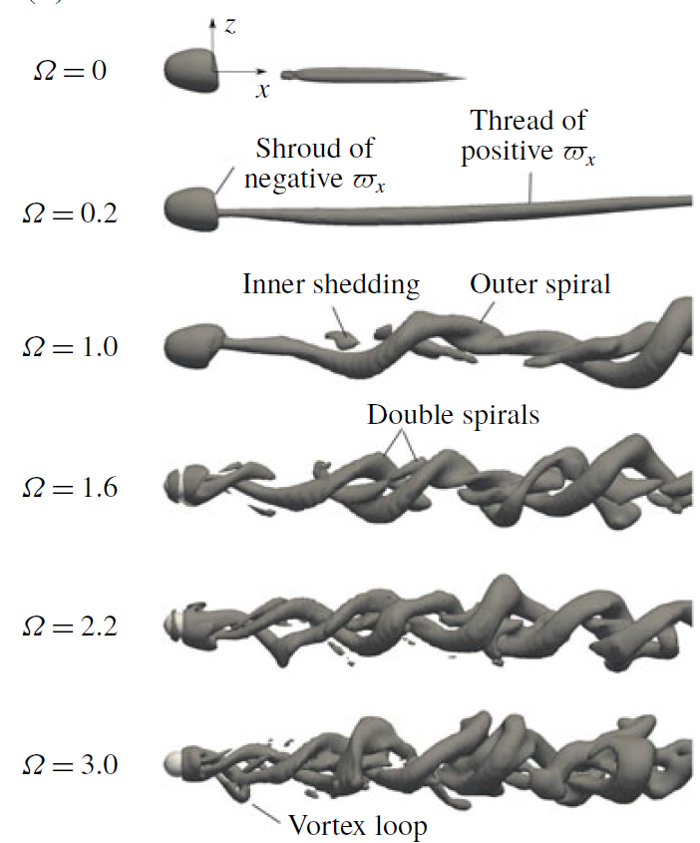
Background
Previous studies at higher rotating rates: double helix (High-helical frozen regime) and chaotic (with vortex shedding) regimes
Re =250
Re =250
Ω = 0
Re =250
Ω = 0.2
Ω = 0.5
Ω = 0.8
Ω = 0.8
Ω = 1.2
Ω = 1.2
Lorite-Díez & Jiménez-González
(JFM2020)
Skarysz et al. (PRF18)
14th ERCOFTAC SIG 33 WORKSHOP
M. Lorite – Díez et al.
5/16
Notes:
The study went to higher parameters of rotation, it’s remarkable the study from Skarysz and JE Wesfreid. Since they were the only able to study this problem experimentally, which is quite hard since you must produce the rotation with very small eccentricity, without perturbing the flow and inside a water channel with quite low velocities. Concerning their results, they observe the appearance of a double helix in the wake when high rotation rates are applied at Re=250.
We obtained similar results through DNS in our previous paper, where we carry simulations at Re=250, 500 and 1000 and rotation parameters up to 3. We observe the appearance of double helix (structures with m=-2 topology), periodic, quasiperiodic and irregular regimes. We also found some regions where multiple solutions can be stable, but, we weren’t able to explain how the obtained regimes emerged, the fundamental modes/frequencies of the flow and predict the flow in other regions different from the ones simulated. Also, numerical simulations are especially expensive close to bifurcation points or when different attractors interact… We wanted to extend this study to modern stability tools and that’s how this collaboration started…

Slide 7
Objectives
New approach: Normal form analysis in bifurcation scenarios with co-dimension > 1
Connection between flow regimes and linear stability of helical modes
Discover the underlying physical mechanisms and predict useful control actuations
Obtain a complete phase portrait of the flow attractors
Unravel the transition to chaotic dynamics
14th ERCOFTAC SIG 33 WORKSHOP
15 – 17 June, Cádiz, 2022
6/16
Notes:
We planned to perform another analysis of the problem using stability tools in order to obtain the building blocks of the dynamics. It was also interesting for Javier, David and Vincenzo since there are regimes with multiple attractors that can be unstable at the same time, originating co-dimension 2 or even 3 regions.
The idea is to study the problem focusing on the stability of the different helical modes that will help us to explain the connection between the different regimes, to find the physical mechanisms of destabilization and to design efficient control strategies based on stability results. Then, we’ll be able to explain the interaction between the different attractors and the way the flow turns chaotic.

Slide 8
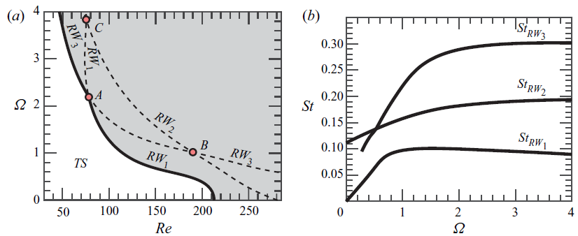
Stability tools (LSA)
Stability of rotating waves (no reflection symmetry due to rotation)
Linear stability analysis of rotating waves
RW₁ (m = -1)
RW₂ (m = -1)
RW₃ (m = -2)
Key: Co-dimension two points
14th ERCOFTAC SIG 33 WORKSHOP
M. Lorite – Díez et al.
7/16
Notes:
To study the problem from stability point of view, we focus on rotating waves that are the predominant type of modes in the flow due to the introduction of rotation (induces a preferential direction). From LSA, the most unstable eigen modes correspond to 3 RW, two with m=-1 topology and another one with m=-2.
The results from LSA are included in the presentation by depicting the bifurcation scenario and the evolution of the frequencies corresponding to each RW at the critical Reynolds number.
The axisymmetric flow around the sphere destabilizes just with RW1 and RW3, RW2 is not obtained directly from TS in the whole region of parameters. In addition, transition curves intersect in three points, which will be crucial in our study. These points are denoted as A, B and C. These points have co-dimension 2, where two attractors turns unstable at them.
But before going to study co-dimension regions, we’ll try to use the LSA results to control the flow. In that case,

Slide 9
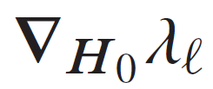
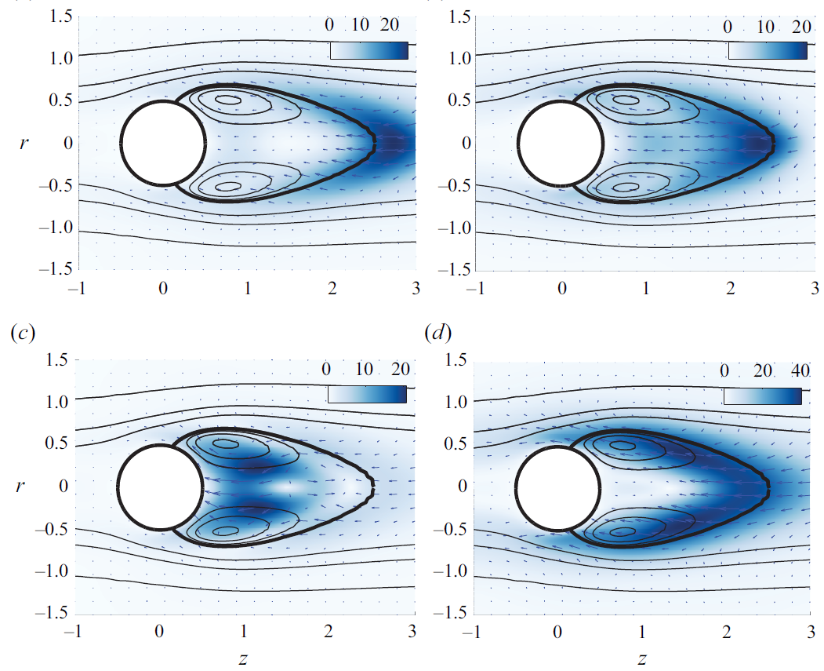
Stability tools (Sensitivity & Control)
Sensitivity to steady axisymmetric forcing term
RW₁ (growth rate)
RW₁ (frequency)
RW₃ (growth rate)
RW₃ (frequency)
14th ERCOFTAC SIG 33 WORKSHOP
M. Lorite – Díez et al.
8/16
Notes:
In that case, we can use sensitivity analysis to evaluate the performance of different control strategies in RW1 and RW3. RW2 is not taken into analysis since is not directly observable (as bifurcation scenario already depicted). The idea is to find some regions where control elements will have a great impact in the leading unstable modes of the flow and will be more efficient to control the unsteadiness. The first approach studied here corresponds to a steady axisymmetric control element that will have a great impact on RW1(for both frequency and amplitude) if it is placed at the end of the recirculation region behind the sphere. Conversely, when, this strategy is applied on RW3, the most sensitive zones are different for amplitude (which are located in the core of the recirculation bubble) and frequency (along the separatrix of the recirculating bubble.
We have also explored the use of…

Slide 10
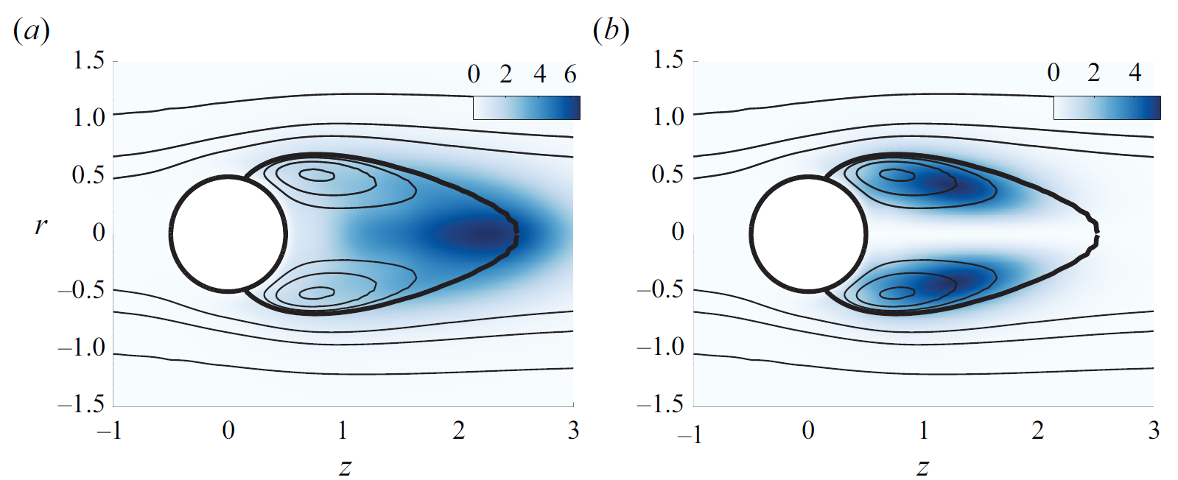
Stability tools (Sensitivity & Control)
Sensitivity to local feedback (Spectral norm of the structural sensitivity tensor)
RW₁
RW₃
14th ERCOFTAC SIG 33 WORKSHOP
M. Lorite – Díez et al.
9/16
Notes:
Another control strategy, based on a localized feedback is explored based on our LSA results. If we plot the norm of the structural sensitivity tensor, we can see how the sensitive zones for harmonic forcing changes for both RWs. For RW1, the most sensitive region is placed at the end of the recirculation bubble, while for RW3 the localized feedback is quite effective in the core of the recirculating eddies.
But this is just a simple study to explore the different possibilities of control for these type of flows, let’s back to our analysis of co-dimension higher than 1

Slide 11
Stability tools (Normal form analysis)
Carried out by via a multiple scale expansion (up to fifth order) of the linear N-S solution
Weakly non-linear expansions in terms of Ω and Re (cubic coefficients of the normal form)
Non-diagonal terms of the normal form are obtained by the expansion of co-dimension two points
14th ERCOFTAC SIG 33 WORKSHOP
M. Lorite – Díez et al.
10/16
Notes:
As I introduced, we want to extend the LSA analysis to the whole parameter region. In order to do so, we expand the different modes via multiple scales expansion up to 5th order of the linear N-S solution. We are varying two parameters, so, the expansion has to take place depending on \Omega and Reynolds, using weakly-non linear approach (we need cubic coefficients to do that). Using this idea, we study the problem by following the three leading rotating waves through normal form analysis.
The diagonal terms corresponds to expansion of LSA leading RWs.
The non-diagonal terms of the normal form are obtained from the key points (A, B, C) which give partial answers to the complex problem.

Slide 12
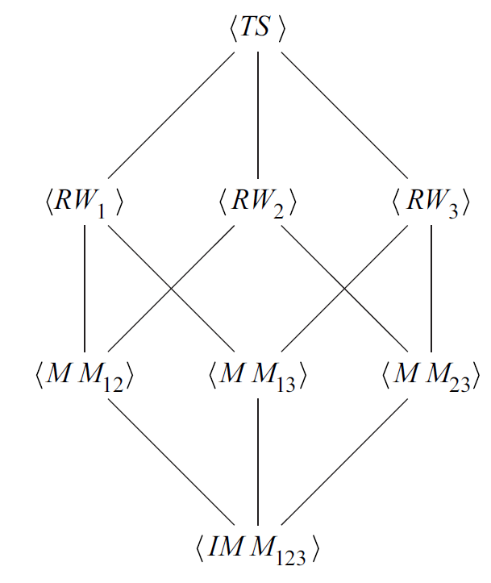
Stability tools (Normal form analysis)
Classification of solutions: rotating waves (RW_{i}), mixed modes (MM_{ij}) and interacting mix modes (IMM_{ijk})
RW₁ → LF
RW₂ → MF
RW₃ → HF
MM₁₂ → LF + MF
MM₁₃ → LF + HF
MM₂₃ → MF + HF
IMM₁₂₃ → LF + MF + HF
14th ERCOFTAC SIG 33 WORKSHOP
M. Lorite – Díez et al.
11/16
Notes:
Using this approach, we can find different type of solutions as the parameters are varied. So, quasiperiodic regimes where two rotating waves interact appear. Also, there is the possibility that the problem goes to different attractors for the same parameter values leading to bistable states. Following that, the TS can go ideally to the three RWs states where only one unstable mode (or frequency) is present in the flow (Co-dimension 1). After that, each rotating wave can go to a mixed mode solution where 2 frequencies interact (one of them was already present in the previous regime, give an example RW1 can only go to MM12 and MM13) (Co-dimension 2). To name the different frequencies, we associate LF to RW1 (single frozen helix), MF to RW2 (vortex shedding) and HF to RW3 (double frozen helix). Finally, all mixed modes converge to a single complex state where the three frequencies interact (Co-dimension 3) that can eventually lead to chaotic dynamics (Interacting mixed mode). To see this more practically, let’s fix the rotation parameter

Slide 13
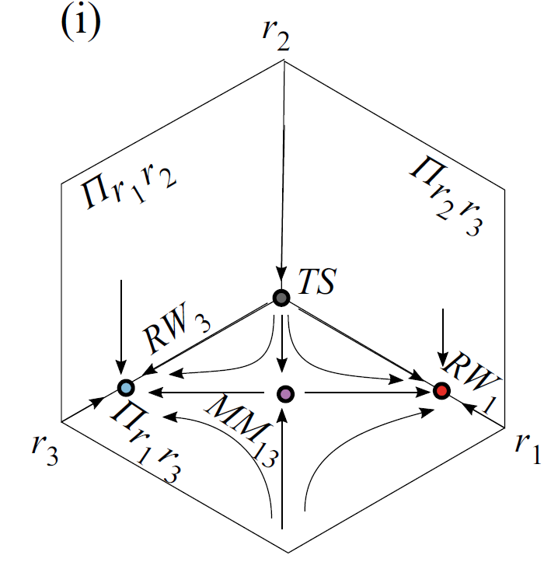
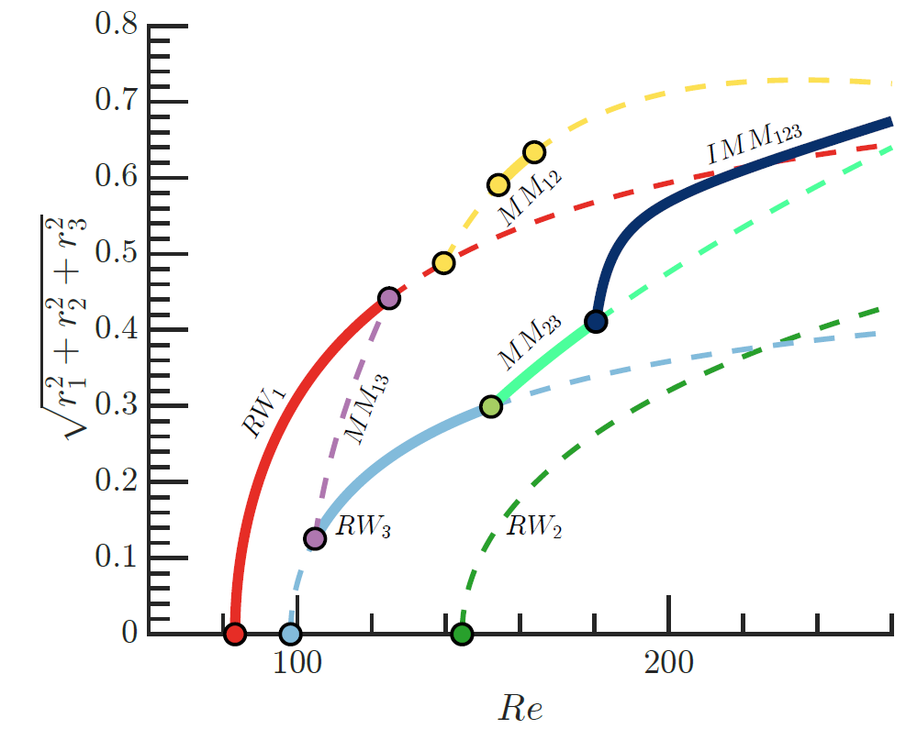
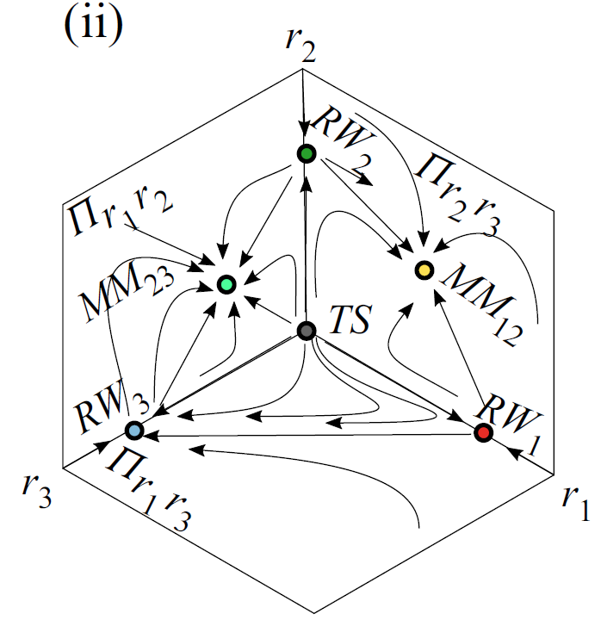
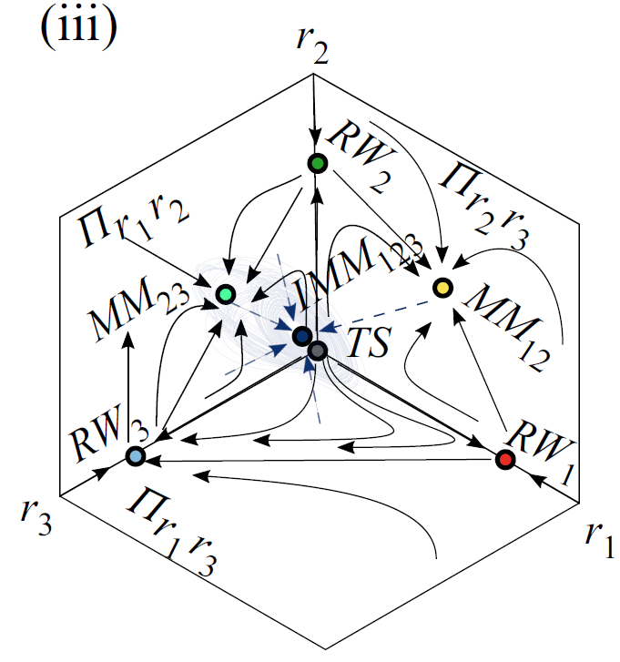
Stability tools (Normal form analysis)
Bifurcation scenario at Ω = 1.75
Multiple attractors → Bistability
14th ERCOFTAC SIG 33 WORKSHOP
M. Lorite – Díez et al.
12/16
Notes:
At \Omega = 1.75, the normal form analysis gives the following results (depicted here by means of the amplitudes of the velocity fluctuations, r1, r2 and r3).
So, starting from trivial state, RW1 first becomes unstable being the only possible attractor up to Re almost 100 where RW3 starts, however, only up to 105, both regimes are stable attractors (they need MM13 branch to appear). In the first portrait from the left, we can see how the flow can go from TS directly to RW1 or Rw3 or it can pass through MM13 but it does not remain there. Please note, that there is a range of Re where both independent attractors RW1 and RW3 are stable. Once the unstable Branch of RW2 appears, the other two mix mode regimes became dominant (being also both of them stable co-dimension 2 bistable). The associated phase portrait is included in the slide (where you can see how you can go from the simple RW to the mixed mode regimes).
Finally, all the branches converge to one single attractor, IMM123, which is a fixed-point solution of the normal form but it can be hidden by chaotic attractors emerging according with Newhouse-Takens-Ruelle theorem.
As you can see, we can perfectly follow the series of bifurcations and the emergence of the different modes/regimes with this method. However, given the complex and non-linear nature of the problem, we want to validate our results with fully non-linear DNS.

Slide 14
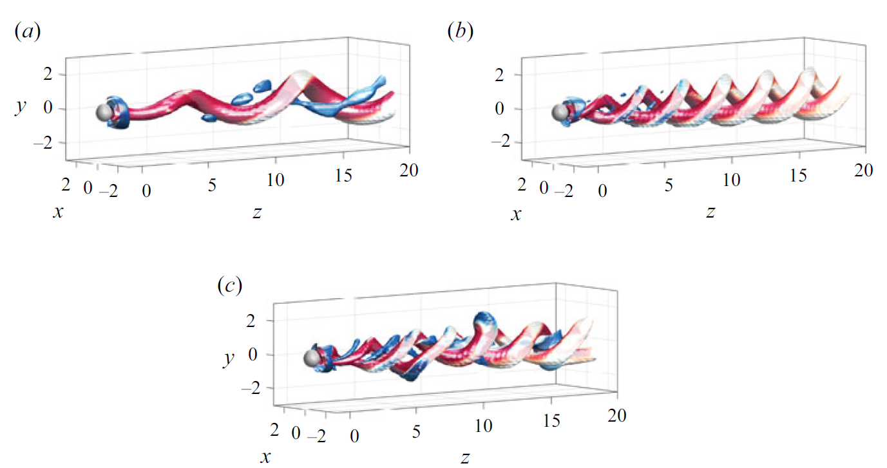
Direct numerical simulations
Bifurcation scenario at Ω = 1.75
2 families of DNS
RW₁
RW₃
Re = 110
MM₁₂
MM₂₃
Re = 150
IMM₁₂₃
Re = 210
14th ERCOFTAC SIG 33 WORKSHOP
M. Lorite – Díez et al.
13/16
Notes:
In that case, we employ the aforementioned computational domain and we fixed the rotation parameter at 1.75 too.
The simulations are performed using two different initial solutions, one from TS at Re=70 with no rotation (Family 1) (and then we increase the Re while fixing the rotation) and another one (Family 2) from our HFH mode obtained at Re=250 and Omega 2.2 (previous work at 2020).
Following this strategy, we obtain at Re=110 the two rotating wave solutions (bistable, as normal form analysis predicted). Depicted by Q-criterion colored by streamwise vorticity… RW1 consists in a single helix (m=-1) rotating at a fixed frequency and RW3 has the same behavior but with a double helix (m=-2) . Using these solutions, we increase the Re, to go to another bistable region where MM12 and MM23 are obtained. Here, RW2 starts to interact with the previous solutions, originating vortex shedding in the wake (blue vortices).
If we further increase the Re, the three-frequencies regime appear for both families of DNS. The wake is complex as it combines the three unstable modes. But let’s compare more quantively…

Slide 15
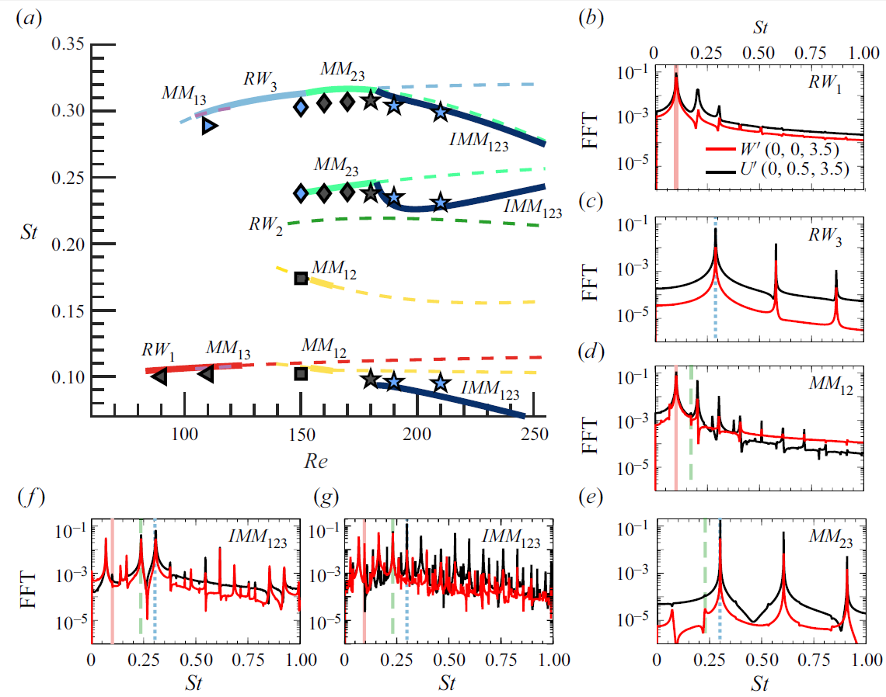
Direct numerical simulations
Validation at Ω = 1.75: frequencies and HODMD
Re = 110
Re = 181
Re = 210
Re = 150
14th ERCOFTAC SIG 33 WORKSHOP
M. Lorite – Díez et al.
14/16
Notes:
Here, we start the validation of our normal form approach by comparing the frequencies associated to each mode. We represent family I in black while and Family 2 in blue. The agreement between both methods is quite good and it can be used to illustrate the bifurcation scenario and the appearance of different modes. In addition, some spectra from streamwise and radial velocity fluctuations are included to show the temporal characteristics of the flow (the fundamental frequencies are highlighted with vertical lines). We can see periodic Flow regimes at Re=110, quasiperiodic (of order 2 at Re=150, of order 3 at Re=181). It should be also noted that when we further increase the Reynolds number, the dynamics turns chaotic, displaying a nearly continuous spectra. Following the validation…

Slide 16
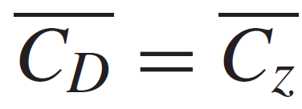
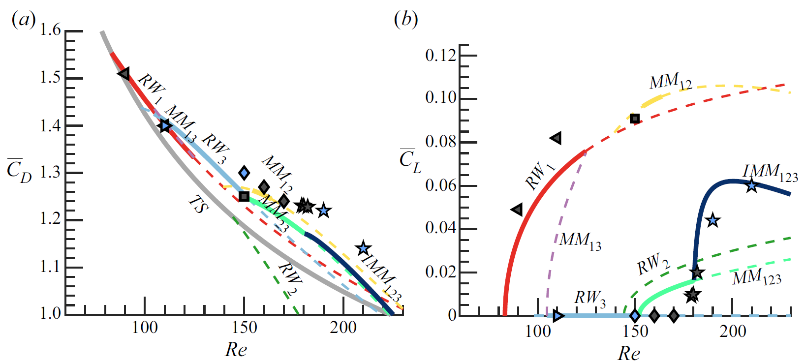
Direct numerical simulations
Validation at Ω = 1.75: force coefficients
14th ERCOFTAC SIG 33 WORKSHOP
M. Lorite – Díez et al.
15/16
Notes:
We can compare force coefficients between simulations and normal form analysis (again, it can be also used to illustrate the pattern formation). Here, we employ drag and the total lift coefficient. The color code for DNS is based on families. The agreement is quite good, the appearance of the new regimes are effectively captured by the forces. We can observe some disagreements in MM_23, however, this is caused by the low amplitude associated to RW2 in DNS (as we can see in the spectra). All in all, the normal form analysis seems to be a good tool to study this problem, given the reduced time needed to obtain the flow dynamics (DNS are very expensive, especially close to bifurcations). So…

Slide 17
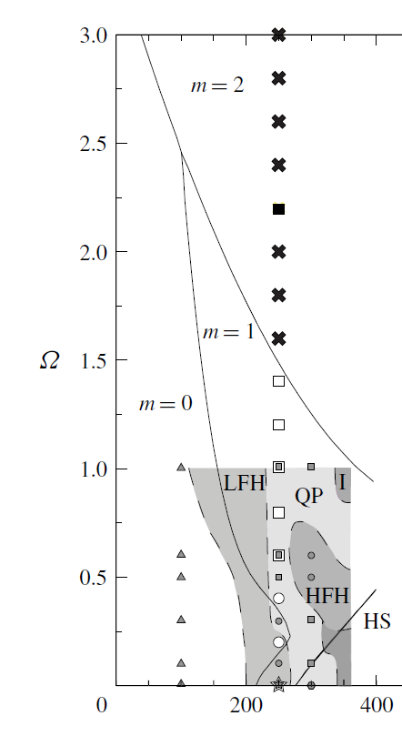
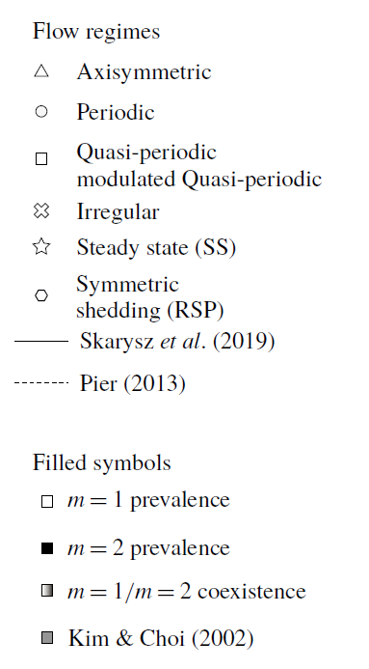
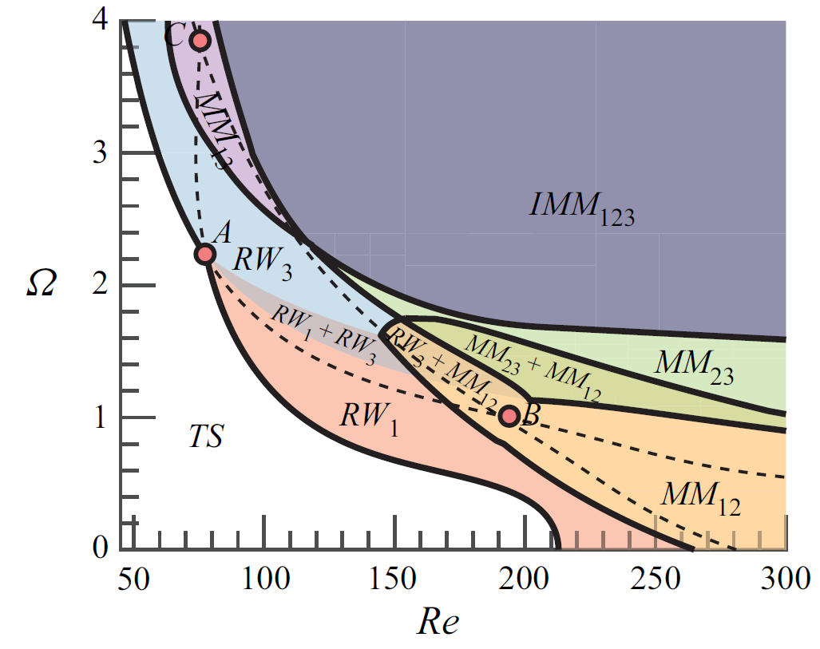
Conclusions
Pattern formation
Stability and interaction of rotating waves
Control possibilities
Ruelle-Takens-Newhouse route to chaos
14th ERCOFTAC SIG 33 WORKSHOP
M. Lorite – Díez et al.
16/16
Notes:
We can try to see the global map of the bifurcation scenario using the normal form, where all the regimes are identified and the different regions with codimension (0, 1,2 and 3) are effectively detected. As you can see, A, B and C points are the key points that organized all the regions. In comparison with the results from previous studies, we have clarified the origin, the nature and the evolution of the different modes, the existence of multiple attractors and the flow route to chaos. In addition, the use of stability tools has helped us to reduce computational time and provide some insights about future control strategies.

Slide 18
Thank you for your attention
Questions?
J. Sierra-Ausín et al. (2022).
Unveiling the competitive role of global modes in the pattern formation of rotating sphere flows.
Journal of Fluid Mechanics 942, A54.
14th ERCOFTAC SIG 33 WORKSHOP
M. LORITE – DÍEZ et al.
Notes:
That’s all, I hope you have found our study interesting (it has been published in JFM last month), I’ll pleased to answer your questions…

